Slide 1
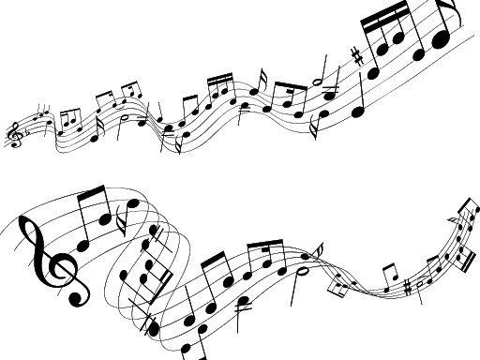
Let’s Focus on Pronunciation
Notes:
Session 1 The Melody of English

Slide 2
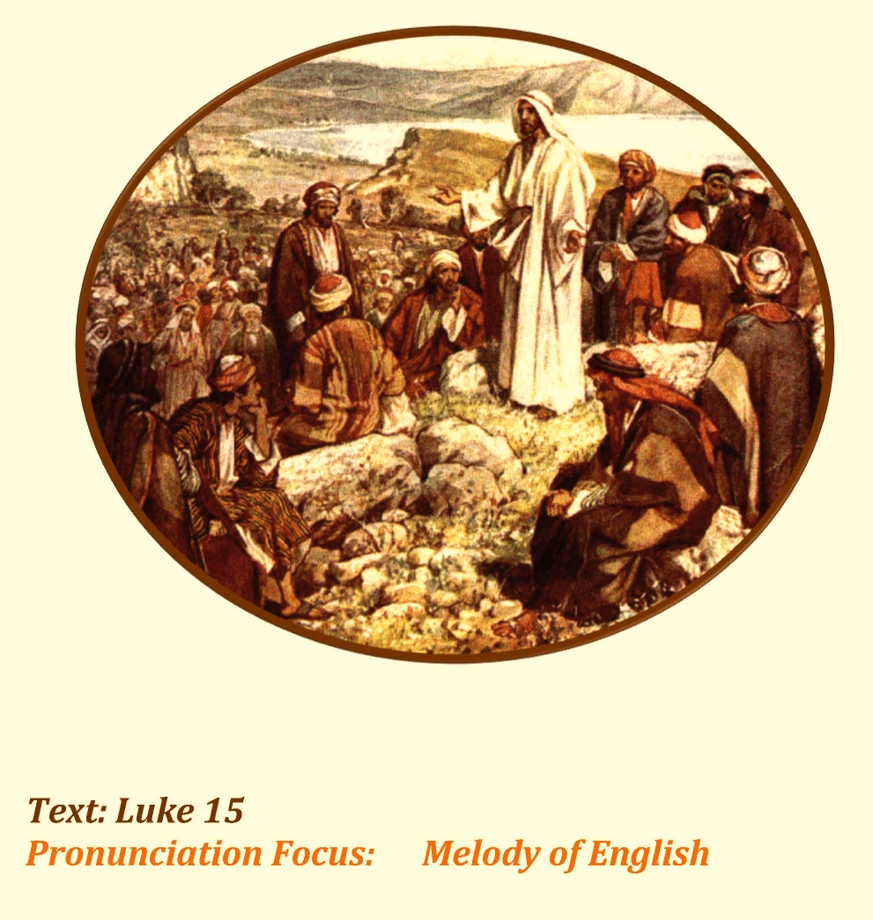
The Prodigal Son
Notes:
Jesus
Project the Jesus Teaching People SLIDE. Explain that this is an artist’s picture of Jesus from the Bible.
Explain that we are going to study one of Jesus’ stories that He told and use that story for words and phrases and sentences to talk about pronunciation. The Prodigal Son . Jesus Teaching People SLIDE

Slide 3
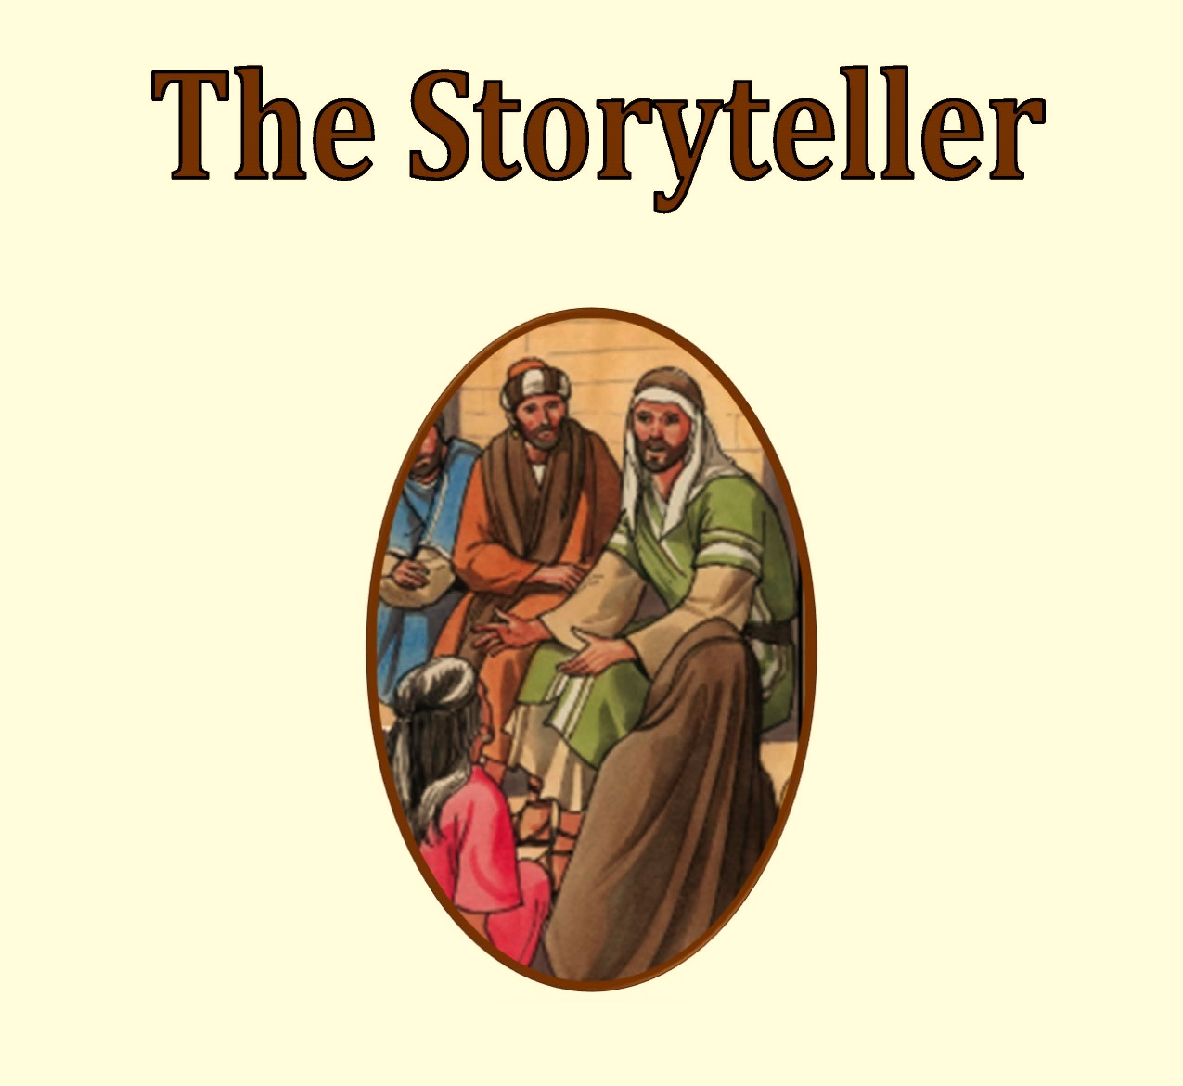
Notes:
Display The Storyteller Title Page SLIDE. Elicit from the learners what they observe in the picture.

Slide 4
Who were the listeners?
Who was the storyteller?
Notes:
Discuss who the listeners were and who the storyteller was.

Slide 5
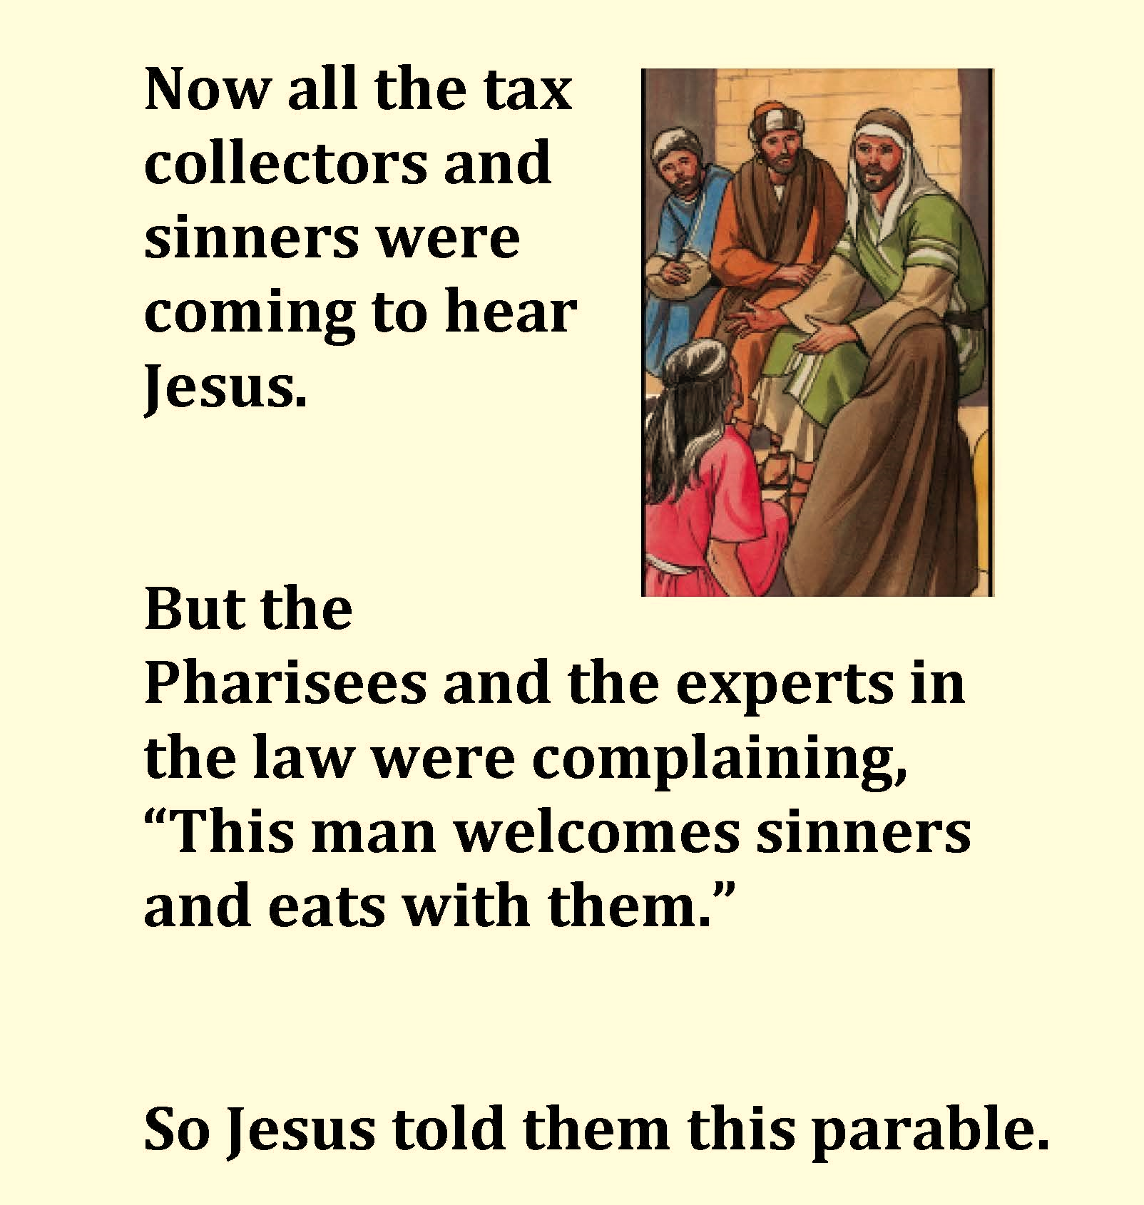

Notes:
Display the Text SLIDE. Click on the Audio Icon to Listen to the text.
Now all the tax collectors and sinners were coming to hear Jesus.
But the Pharisees and the experts in the law were complaining, “This man welcomes sinners and eats with them.” So Jesus told them this parable

Slide 6
Who were the listeners?
Who was the storyteller?
Notes:
Discuss who the listeners were and who the storyteller was.

Slide 7
Beautiful singing of birds
Notes:
A Spanish speaking language professor once said that English was his favourite language because of its musical sounds like songs – that beautiful singing of birds!

Slide 8
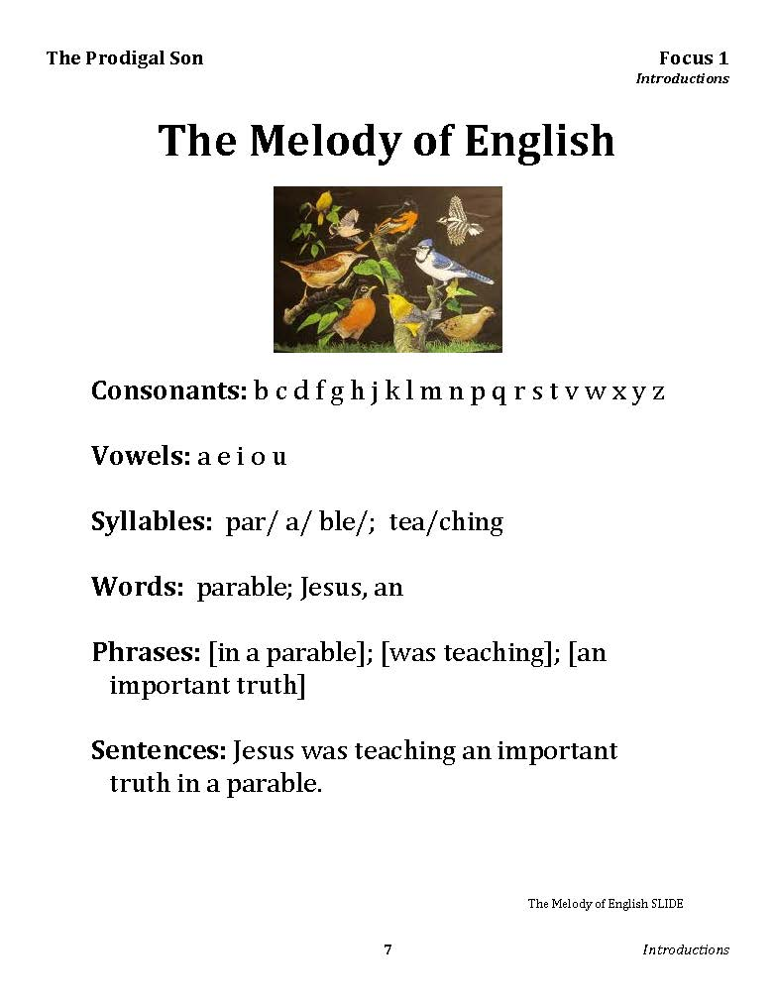

Notes:
Using The Melody of English SLIDE explain to the learners that pronunciation has two main aspects:
a) The individual sounds of vowels and consonants – the smaller pieces
b) The ‘melody’ and tone of phrases, sentences and longer pieces of language (also called ‘prosody’).
Vowel and consonant segments combine into syllables; syllables combine into words; and words combine into phrases and sentences. But the process of producing connected speech affects the pronunciation of several of these segments in a number of interesting ways producing a beautiful but meaningful melody.

Slide 9
Syllables
par/a/ble/
tea/ching
Notes:
Syllables: par/ a/ ble/; tea/ching

Slide 10
Words
parable
Jesus
an
Notes:
Words: parable; Jesus, an

Slide 11
Phrases
[in a parable]
[was teaching]
[an important truth]
Notes:
Phrases: [in a parable]; [was teaching]; [an important truth]

Slide 12
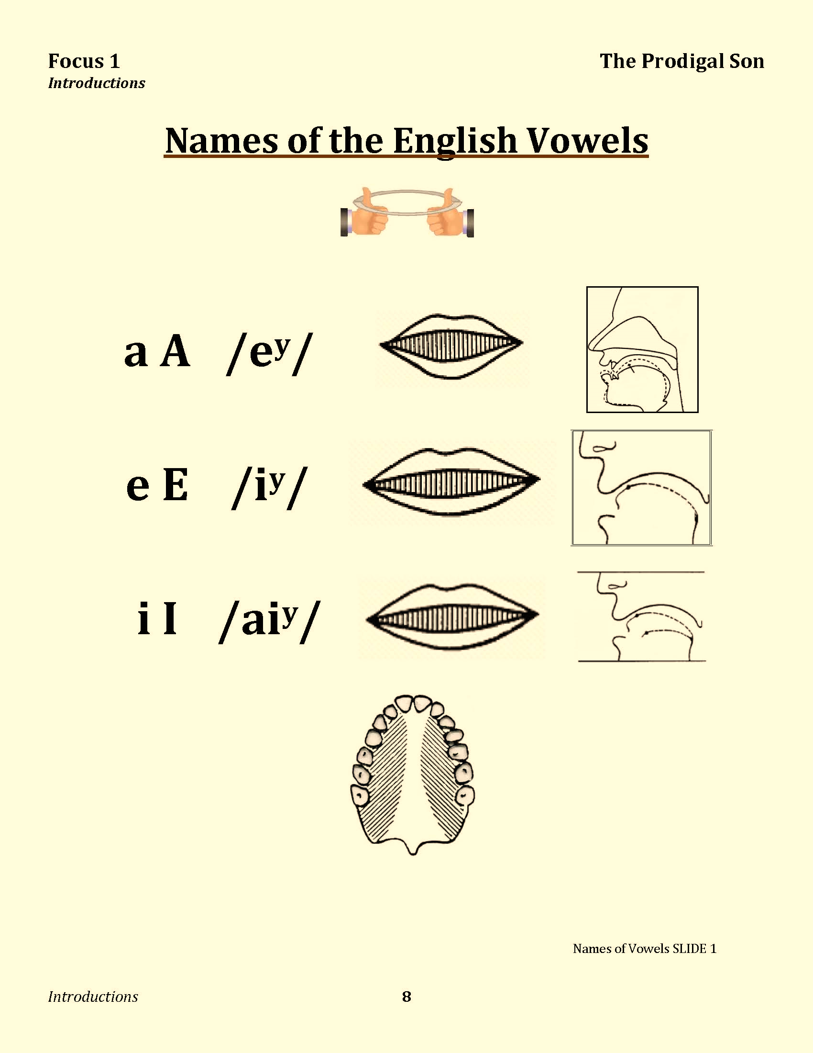
Notes:
Vowels: a e i

Slide 13
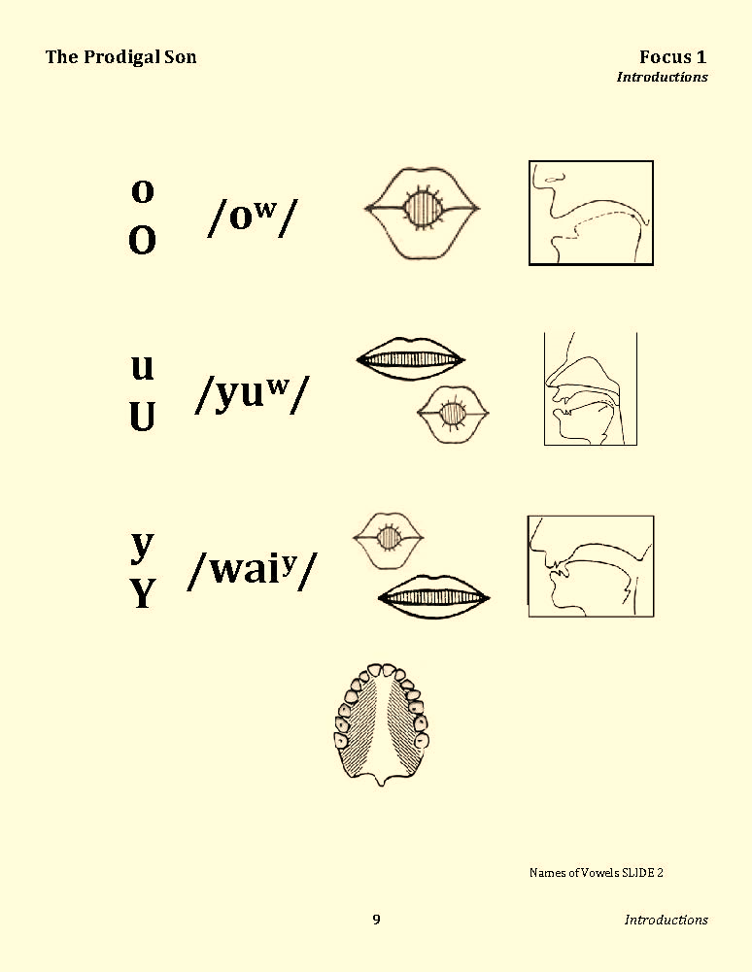
Notes:
Vowels: o u y

Slide 14
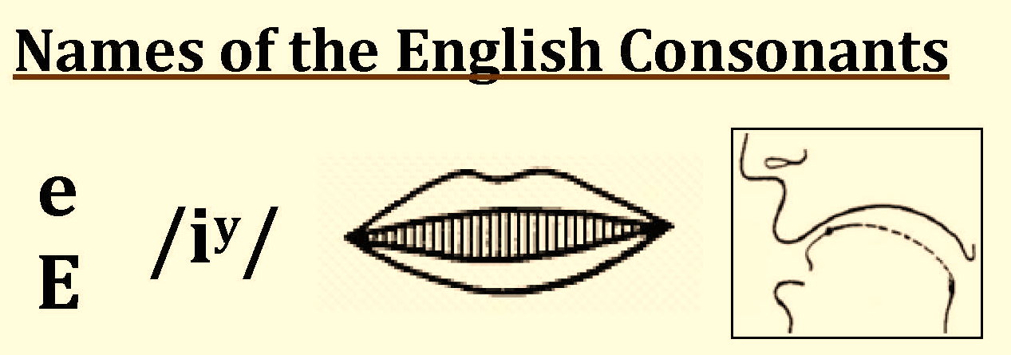
Bb
Pp
Cc
Tt
Dd
Vv
Gg
Zz
Notes:
Consonants [B C D G P T V Z] Animated Click to listen to the individual sounds

Slide 15
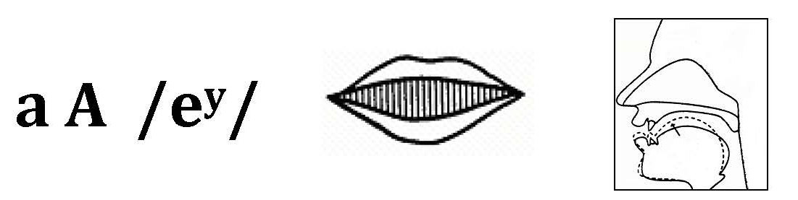
Hh
Jj
Kk
Notes:
Consonants [H J K] Animated Click to listen to the individual sounds

Slide 16
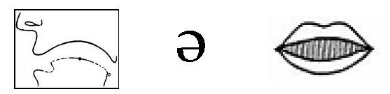
Ff
Nn
Ll
Ss
Mm
Xx
Notes:
Consonants [F L M N S X] Animated Click to listen to the individual sounds

Slide 17
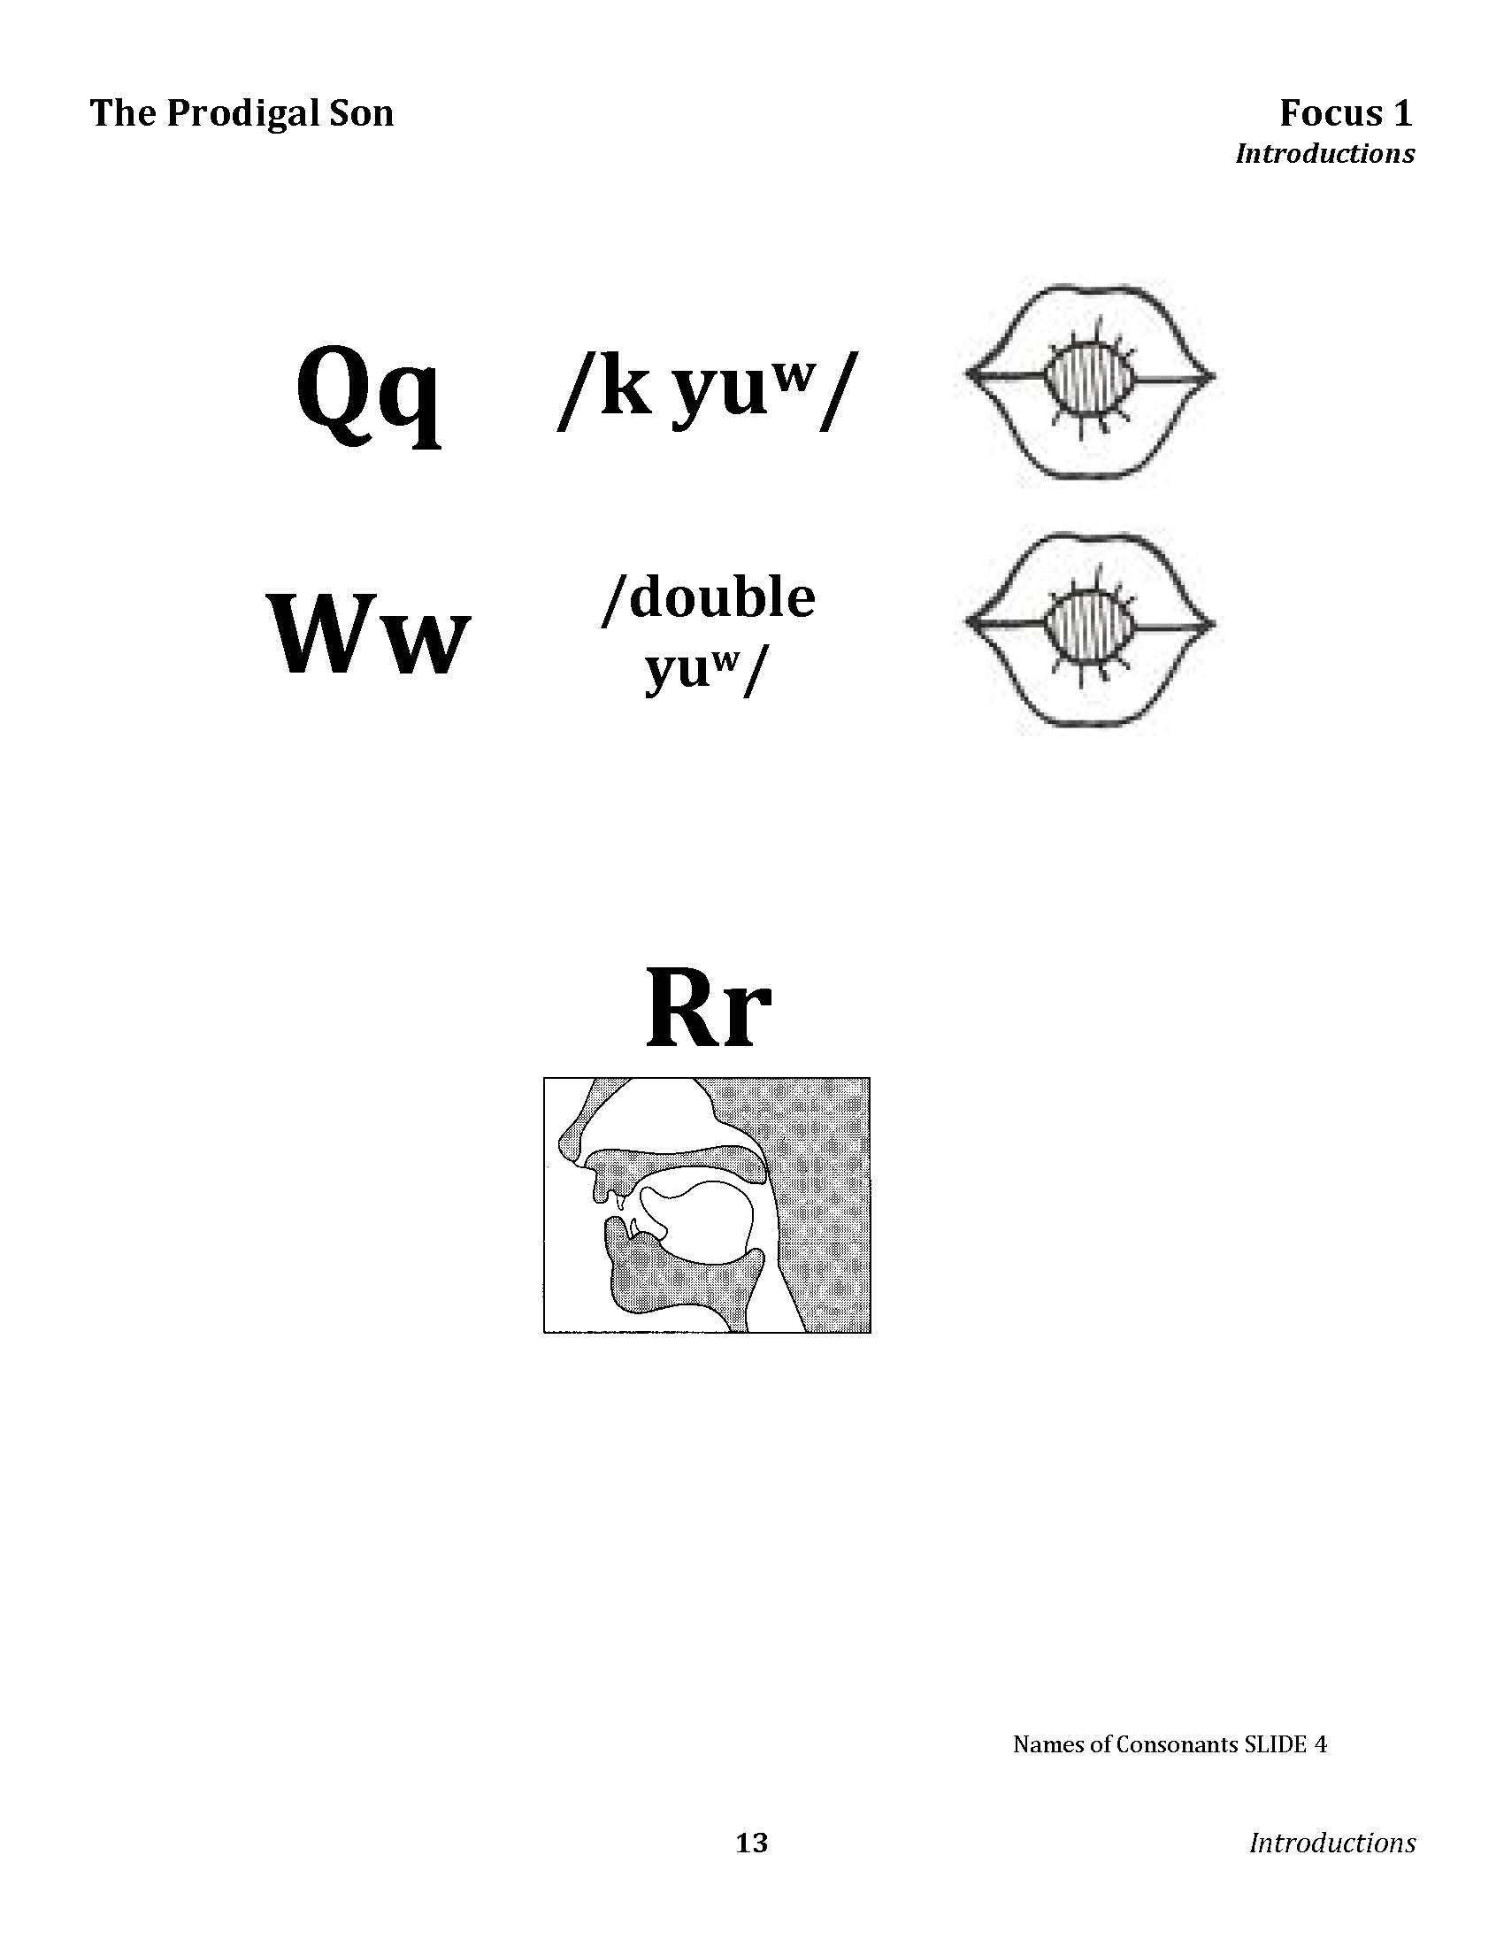
Notes:
Consonants [Q W R] Animated Click to listen to the individual sounds

Slide 18
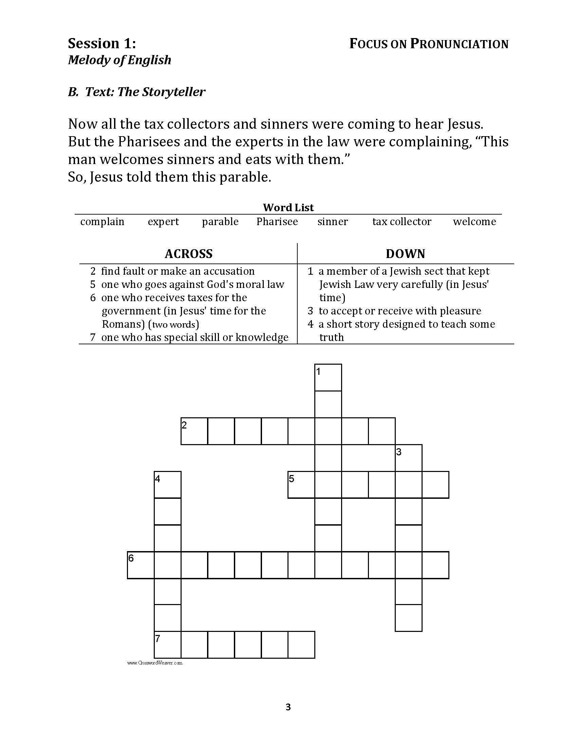
Notes:
Hand out the Crossword Puzzle. (Work in Breakout Groups)

Slide 19
The Storyteller
complain
sinner
expert
tax collector
parable
welcome
Pharisee
Notes:
Point out the list of words at the top of the page. Read the list and have the learners repeat them after you. Be sure to say them with the normal stress pattern: complain expert parable Pharisee sinner
tax collector welcome

Slide 20
Now all the tax collectors and sinners were coming to hear Jesus. But the Pharisees and the experts in the law were complaining, “This man welcomes sinners and eats with them.”
So, Jesus told them this parable.
Notes:
Circle the Crossword Puzzle words in the Text. Animated Answer Key.

Slide 21
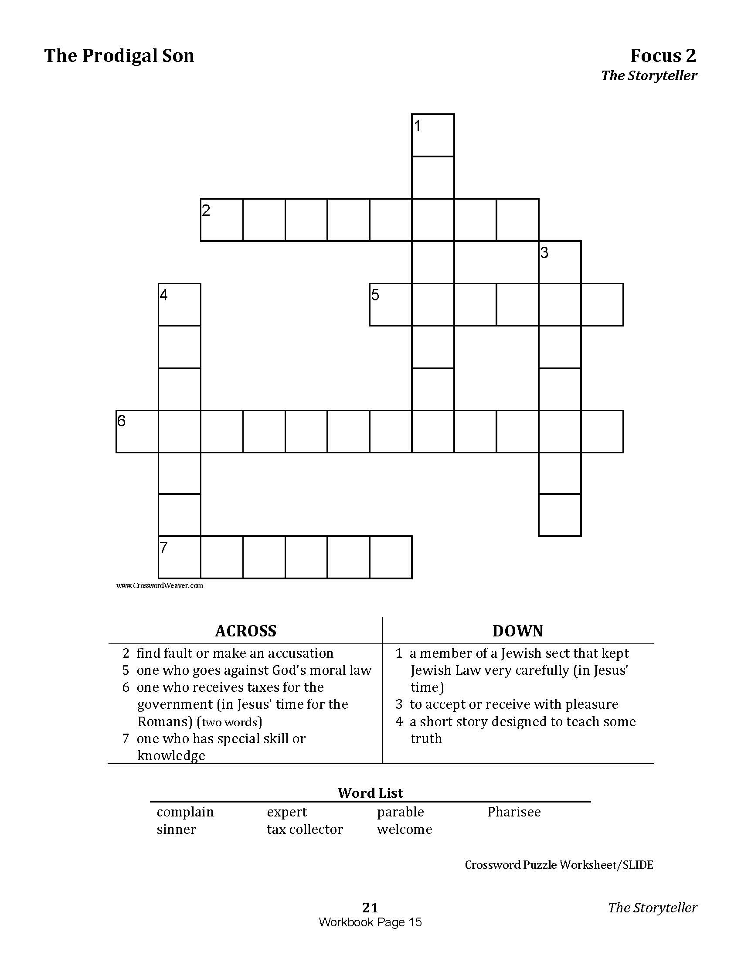
Notes:
Direction ACROSS & DOWN for answers to the clues

Slide 22
Notes:
Clues ACROSS and clues DOWN

Slide 23
Work with your group on the crossword puzzle.
Notes:
Ask the learners to fill in the blanks. (Illustrate with the first one.) Ask them to compare with another learner.
Work in Breakout group: Leader guides them through group discovery..

Slide 24
P
H
C
O
M
P
L
A
I
N
R
W
P
S
I
N
N
E
R
A
S
L
R
E
C
T
A
X
C
O
L
L
E
C
T
O
R
B
M
L
E
E
X
P
E
R
T
Notes:
Elicit the words from the learners. Fill in the Crossword Puzzle SLIDE while the learners report what fits into each blank. Animated Answer Key

Slide 25
Notes:
The Collector Video

